Slide 1

REGRESSION DS Project Naya 2024
Aleksander Tanskii
Predicting Loan Amount

Slide 2
A bit about the data
The problem
This dataset is part of event conducted on Hackerearth platform.
It was a machine learning challenge, for predicting the sanctioned loan amount
Originally, there were 2 files, train and test on Kaggle (https://www.kaggle.com/datasets/phileinsophos/predict-loan-amount-data/data) The data was intended to be submitted to Hackerearth, therefore, the test data set didn’t contain the target column. The train data set was taken as a full dataset for the project.
The dataset contains information about users that applied for a loan to buy a property unit. The users are of 18-65 y.o. ages, with a range of income and current loan expenses, 8 different professions, various credit scores. 3 unique property locations (rural, Semi urban and urban), income stability (low/high) and the target – Loan Sanction Amount (USD).
In total there are 24 columns with 30K records.
Some columns lacked data (it will be shown later)

Slide 3
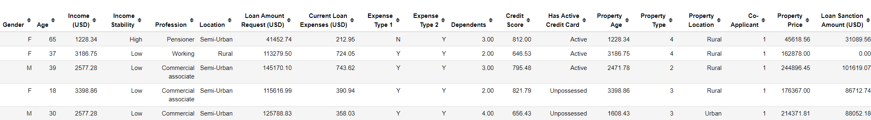
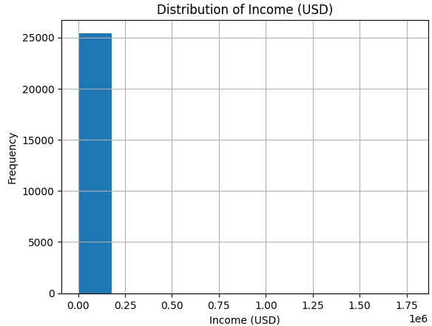
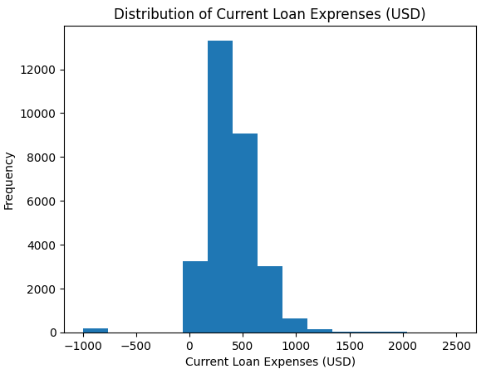
The Data
Conclusion: it was found out that there is 1 outlier in the data which was removed during EDA stage
Conclusion: There are some missing values and rows with -999 values which were cleaned

Slide 4
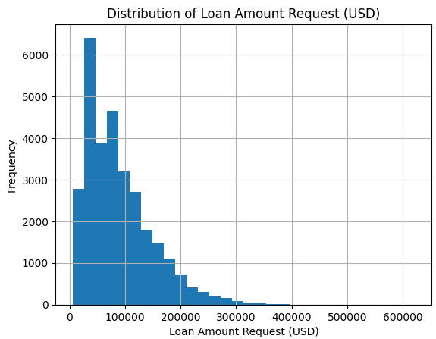
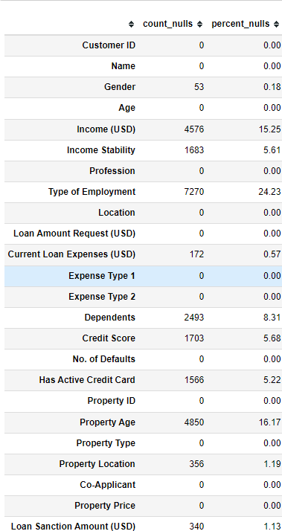
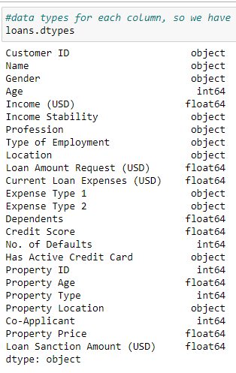
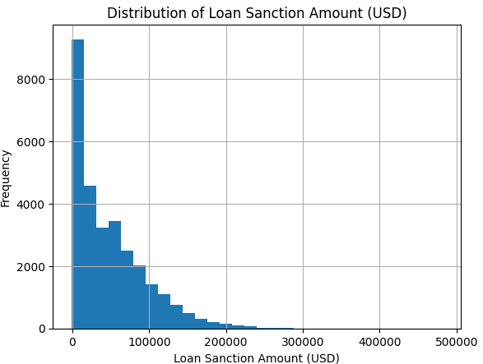
The Data
Conclusion: most of the loans requested are up to 300K with some outliers
Conclusion: mixed types of values
Conclusion: the data contains some columns with missing values which were taken care of in the notebook
Conclusion: the same story can be seen here

Slide 5
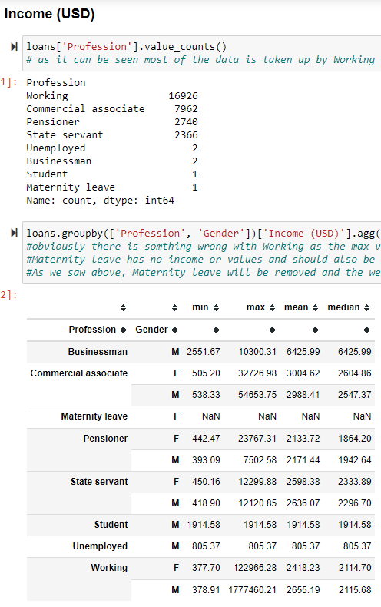
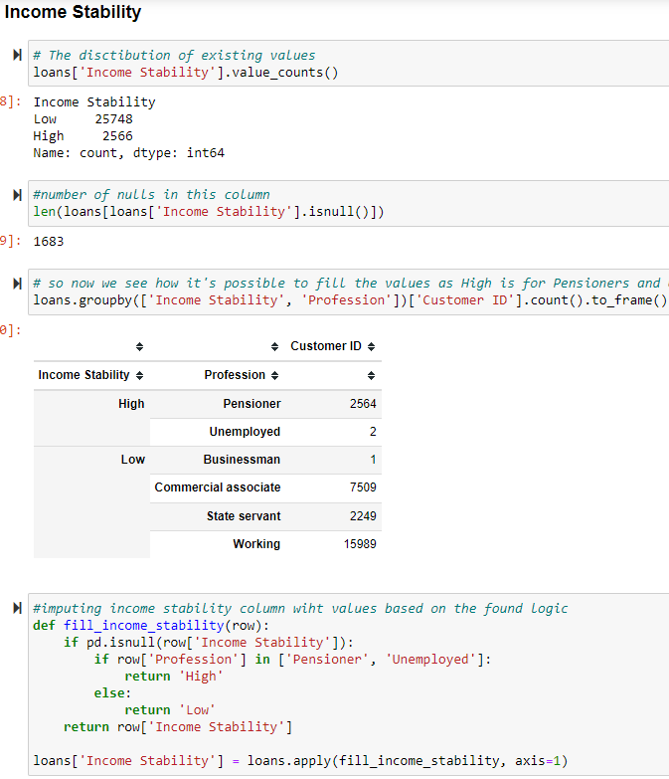
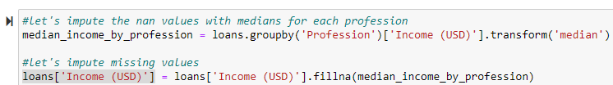
EDA
Imputing Income: median per profession and removing outliers (3)
Imputing Income Stability: Pensioner and Unemployed have High stability of income

Slide 6
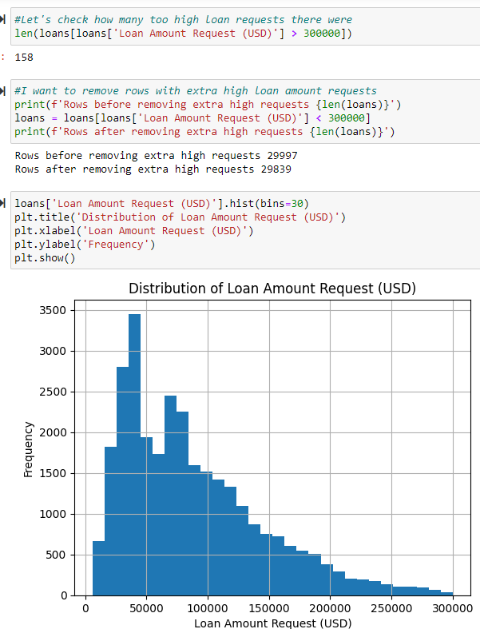
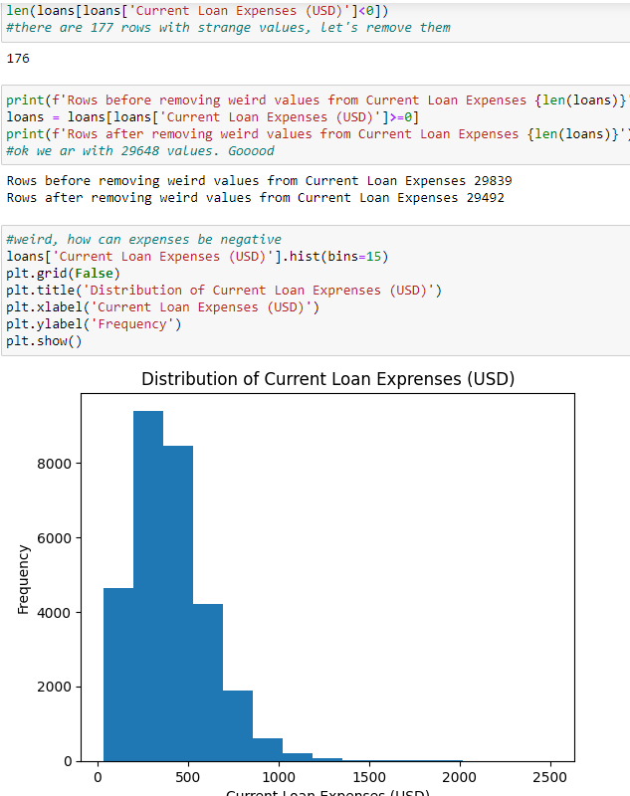
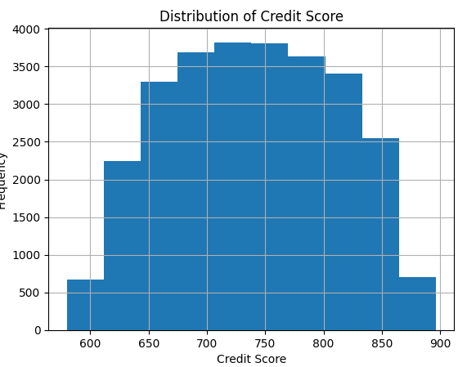
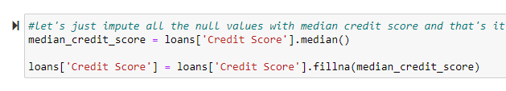
EDA
Imputating credit sore with median
Cleaning Loan Amount Request (USD): everything that is > 300K was removed
Removing rows Current Loan Expenses (USD): everything that is < 0

Slide 7
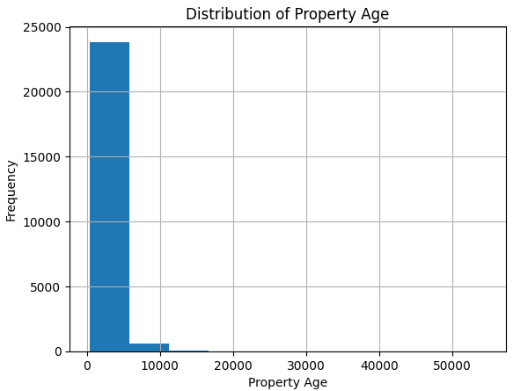
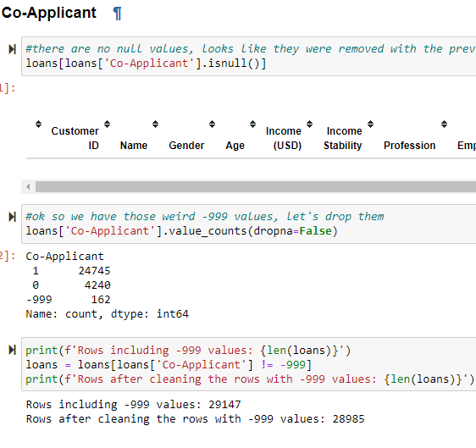
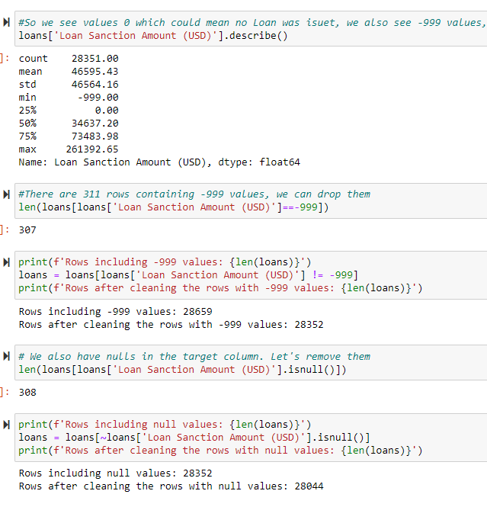
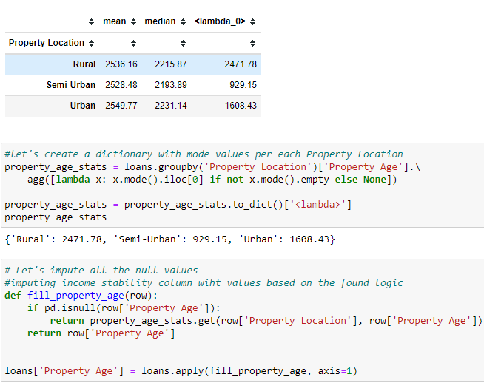
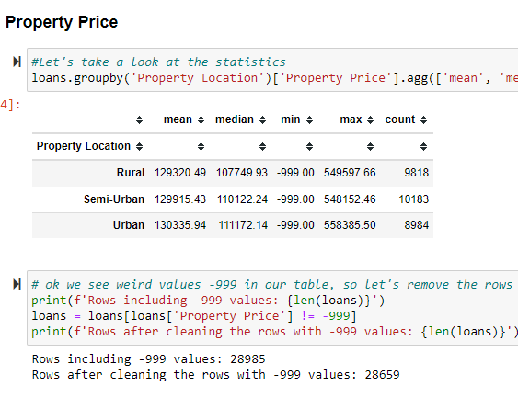
EDA
Cleaning the target, removing rows with -999 values and the rows with missing data. Eventually we are left with 28,044 rows out of 30K, around 6% of data is removed
Imputing Property Age column with mode per location

Slide 8
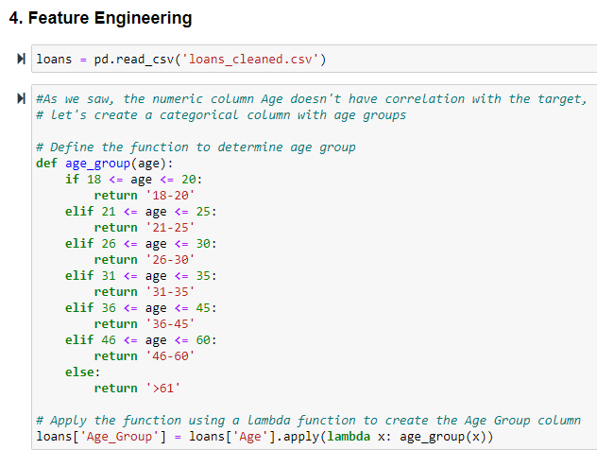
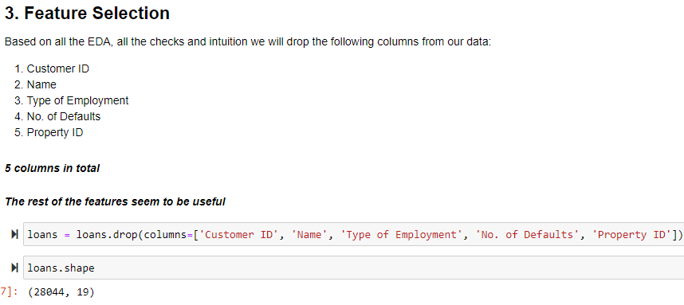
Feature selection
Feature Engineering
Irrelevant columns were removed
It was decided to create another column with age groups, based on later checks it was discovered that for the age of 18 there are most of all 0s in the target

Slide 9
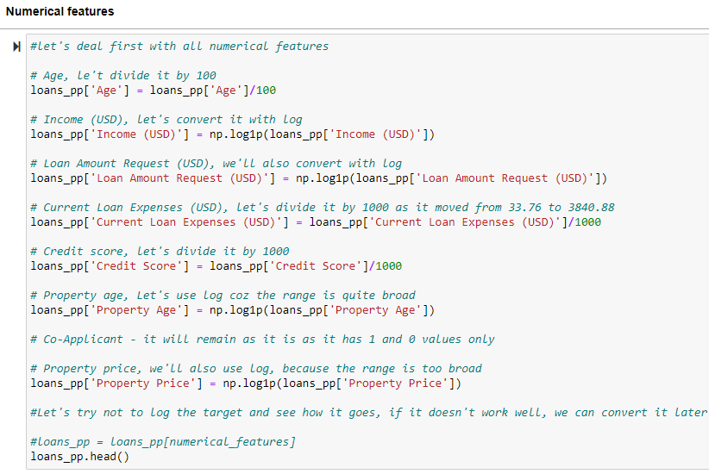
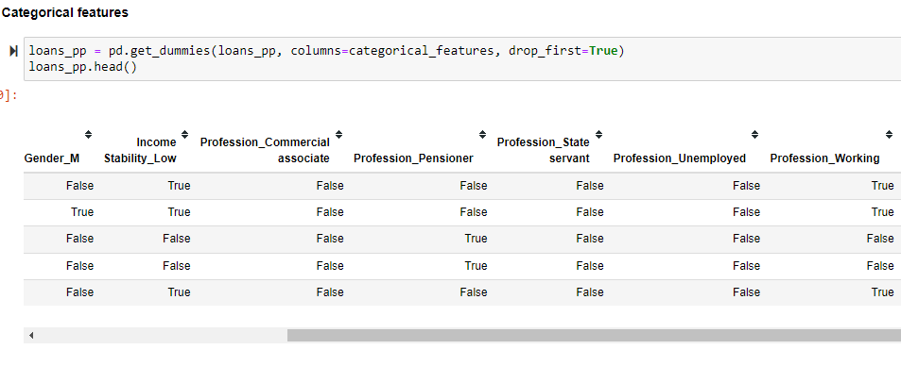
Preprossessing
get_dummies() function was used to create dummy variables from all categorical ones, including the newly created age_group column
It was decided to apply various techniques to scale and log the numerical features in the data

Slide 10
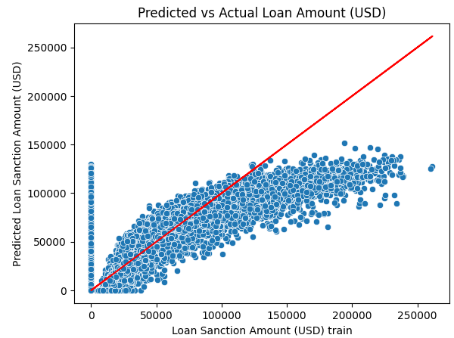
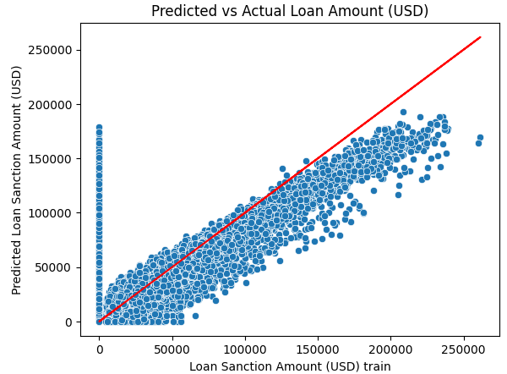
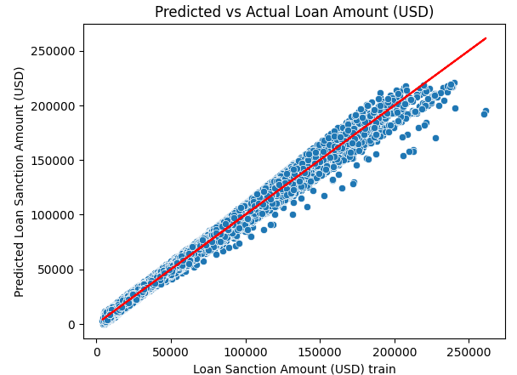
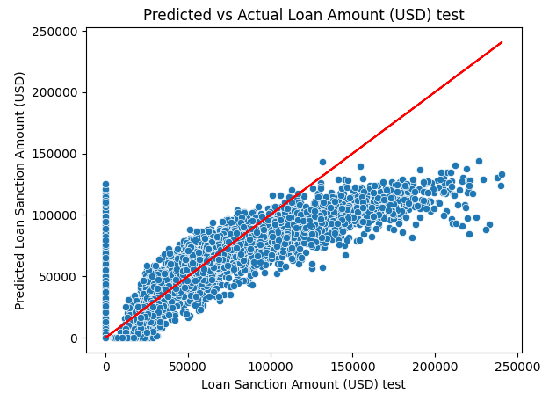
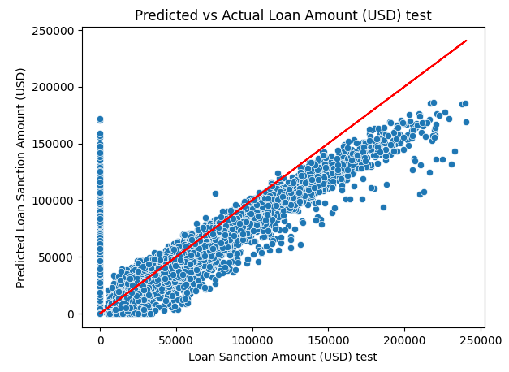
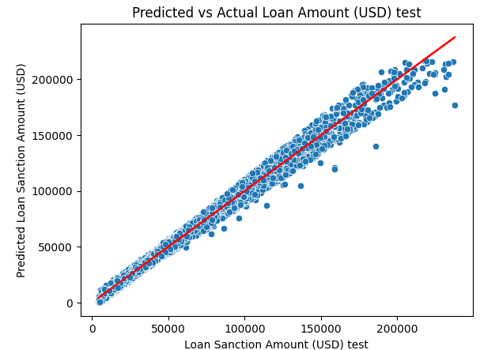
Modeling with Linear Regression
All categorical + numerical features, scaling, logs on everything apart from target, RMSE train: 29361; RMSE test: 29914
Only numerical features with no scaling and no logs. RMSE train: 27216; RMSE test: 27298
Only numerical features with no scaling and logs, removing 0s from target. RMSE train: 5189, RMSE test: 5112

Slide 11
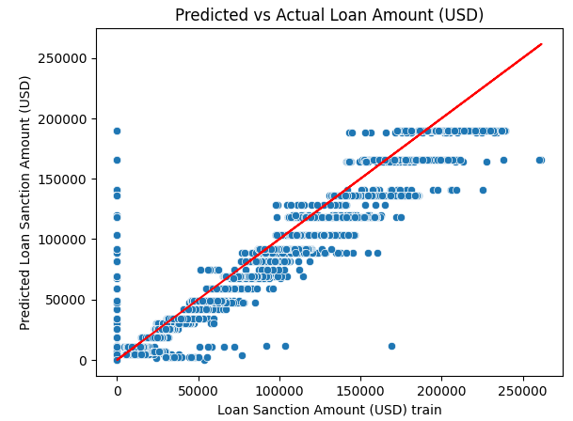
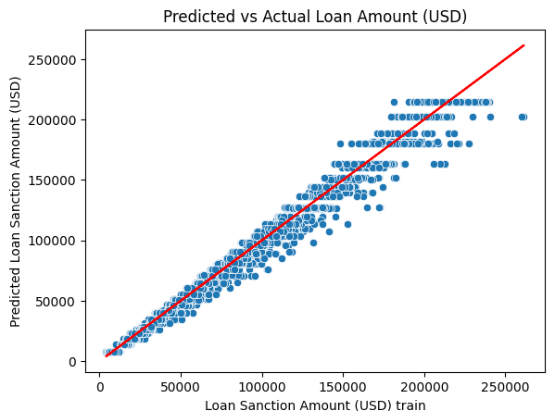
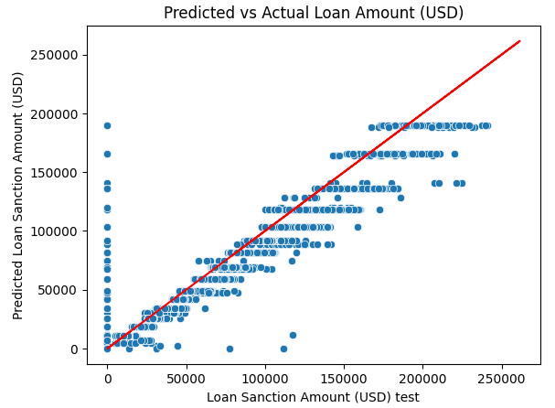
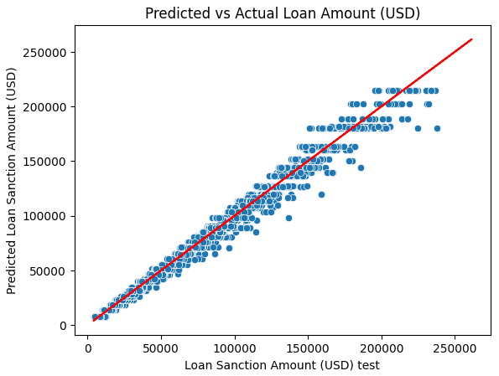
Modeling with Decision Trees
All categorical + numerical features, scaling, logs on everything apart from target, RMSE train: 21707; RMSE test: 21859; 1240/2316 0s caught. 4 false ones
Only numerical features with no scaling and logs, removing 0s from target. RMSE train: 4856, RMSE test: 5013

